Slide 1
Agentic AI

Slide 2
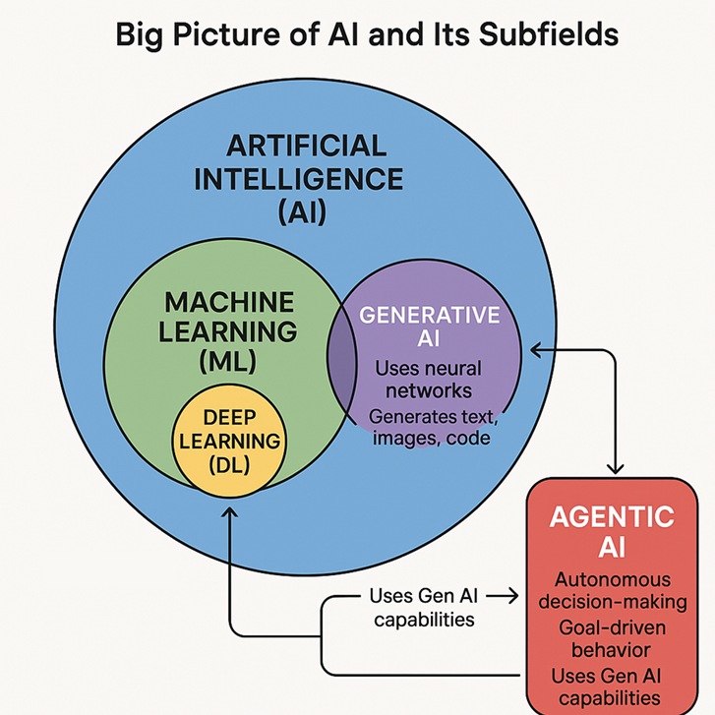
Introduction to AI
Artificial Intelligence (AI)
Definition: AI refers to the simulation of human intelligence by machines, especially computer systems. It enables machines to perform tasks that typically require human cognition, such as understanding language, recognizing patterns, solving problems, and making decisions.
Key Functions of AI
Learning: Acquiring data and rules for using it. e.g. A recommendation engine learning user preferences over time.
Reasoning: Drawing conclusions from data and rules. e.g. Fraud detection systems identifying suspicious patterns.
Problem-Solving: Finding solutions to complex or ambiguous challenges. e.g. AI in logistics optimizing delivery routes.
Decision-Making: Choosing actions based on available information. e.g. Virtual assistants deciding which app to open based on voice commands.
Examples of AI in Action
Virtual Assistants: Siri, Alexa, Google Assistant.
Fraud Detection: AI systems used by banks to monitor transactions.
Recommendation Systems: Netflix, Amazon, Spotify suggesting content or products.

Slide 3
Subset of AI - Machine Learning
ML is a branch of AI that enables systems to learn from data and improve performance over time without being explicitly programmed.
Key Concepts:
Algorithms: Use statistical methods to find patterns in data.
Training Data: ML models learn from historical data.
Model Evaluation: Accuracy, precision, recall, etc.
Types of ML:
Supervised Learning: Labeled data (e.g., spam detection).
Unsupervised Learning: Unlabeled data (e.g., customer segmentation).
Reinforcement Learning: Learning through rewards (e.g., game-playing agents).
Examples:
Email spam filters
Credit scoring systems
Predictive maintenance in manufacturing

Slide 4
Subset of AI - Deep Learning
DL is a specialized form of ML that uses neural networks with many layers to model complex patterns in large datasets.
Key Concepts:
Artificial Neural Networks (ANNs): Inspired by the human brain.
Layers: Input, hidden, and output layers.
Backpropagation: Technique for training deep networks.
Strengths:
Handles unstructured data like images, audio, and text.
Excels in tasks like object recognition and natural language processing.
Examples:
Facial recognition systems
Voice assistants (e.g., Alexa, Siri)
Autonomous driving (e.g., Tesla’s vision systems)

Slide 5
Generative AI

Slide 6
Generative AI (GenAI)
Definition:
Generative AI refers to models that can create new content—such as text, images, music, or code—based on patterns learned from training data.
GenAI is built on deep learning, especially transformer models.
It uses AI techniques to generate novel outputs but is not a distinct hierarchical subset like ML or DL.
Key Capabilities:
Text generation
Image synthesis
Code generation
Music composition
Examples:
ChatGPT (text generation)
DALL·E (image generation)
GitHub Copilot (code suggestions)
Suno AI (music generation)

Slide 7
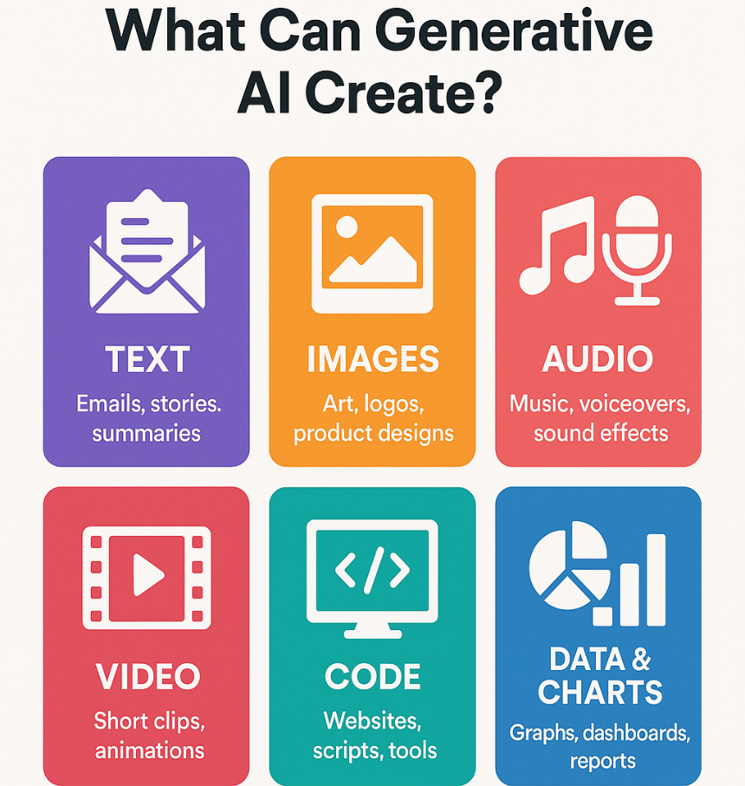
What does GenAI generate?
Generative AI is like a super-smart assistant that can create new content based on what it has learned. Think of it as a tool that can help you write, draw, compose, or even code—without needing to be an expert yourself.
Text
Examples: Emails, blog posts, stories, reports, summaries, poems
Use Case: You give it a topic, and it writes something for you—like drafting a client email or summarizing a long document.
Images
Examples: Artwork, logos, product designs, illustrations
Use Case: You describe what you want (e.g., “a futuristic city at sunset”), and it creates a picture from scratch.
Audio & Music
Examples: Background music, sound effects, voiceovers
Use Case: It can compose music for a video or generate a voice reading a script.

Slide 8
What does GenAI generate?
Video
Examples: Short clips, animations, video summaries
Use Case: It can help create explainer videos or edit clips based on your instructions.
Code
Examples: Website templates, scripts, automation tools
Use Case: You describe what you want (e.g., “a calculator app”), and it writes the code for you.
Data & Charts
Examples: Graphs, dashboards, reports
Use Case: It can analyze data and create visual summaries for presentations.

Slide 9
How GenAI Understands What to Create –
Generative AI works a bit like a super-smart assistant that has read millions of examples—books, images, code, music, and more. When you give it a prompt (a request or instruction), it uses what it has learned to predict and generate something new that matches your request.
Here’s how it works step-by-step:
1. You Give It a Prompt
Example: “Write a story about a robot in space” or “Create an image of a sunset over mountains.”
The prompt is like a question or instruction.
2. It Understands the Context
GenAI breaks down your prompt using language understanding.
It looks for patterns and meaning based on what it has learned during training.
3. It Predicts What Comes Next
Using its training, it guesses what kind of content would best match your prompt.
For text, it predicts the next word or sentence.
For images, it predicts shapes, colours, and textures.
4. It Generates the Output
You get a story, image, code, or music—created just for you.
It’s not copied from somewhere; it’s new, based on patterns it learned.

Slide 10
Popular GenAI APIs
Organization | API Name | Underlying Architecture | Specific Model | Applications | Licensing
OpenAI | OpenAI API | Transformer | GPT-4, DALL·E, Whisper | Text generation, image generation, speech-to-text, code generation, chatbots | Commercial; usage-based pricing
Google DeepMind | Gemini API | Transformer (Multimodal) | Gemini 1.5 | Multimodal tasks (text, image, audio, video), chatbots, search enhancement | Commercial; integrated with Google Cloud Vertex AI
Meta AI | LLaMA API | Transformer | LLaMA 2 & 3 | Text generation, research, chatbots | Open-source for research and commercial use (with restrictions)
Groq Inc. | Groq API | Transformer (accelerated by LPU) | Supports LLaMA 3, Mixtral | Ultra-fast inference for LLMs | Commercial; usage-based pricing
Databricks | Foundation Model APIs | Transformer | MPT, LLaMA, BGE | Enterprise AI apps, data analytics, chatbots | Commercial; integrated with Databricks platform
Cohere | Cohere API | Transformer | Command R+, multilingual embedding models | RAG, chatbots, semantic search | Commercial; free tier available
DeepAI | DeepAI API | Various (Transformer, CNN) | Various models | Image generation, text summarization, sentiment analysis | Freemium; open access with rate limits
Anthropic | Claude API | Transformer | Claude 3 | Safe and steerable AI assistants, enterprise chatbots | Commercial; available via AWS Bedrock and Anthropic platform
Mistral AI | Mistral API | Transformer (Mixture of Experts) | Mixtral, Mistral 7B | Lightweight and efficient LLM tasks | Open-weight models; API access via platforms like Hugging Face
Hugging Face | Inference API | Transformer, Autoencoder (varies by model) | BLOOM, Falcon, LLaMA, etc. | NLP, vision, audio, multimodal tasks | Mixed (open-source and commercial); API key required

Slide 11
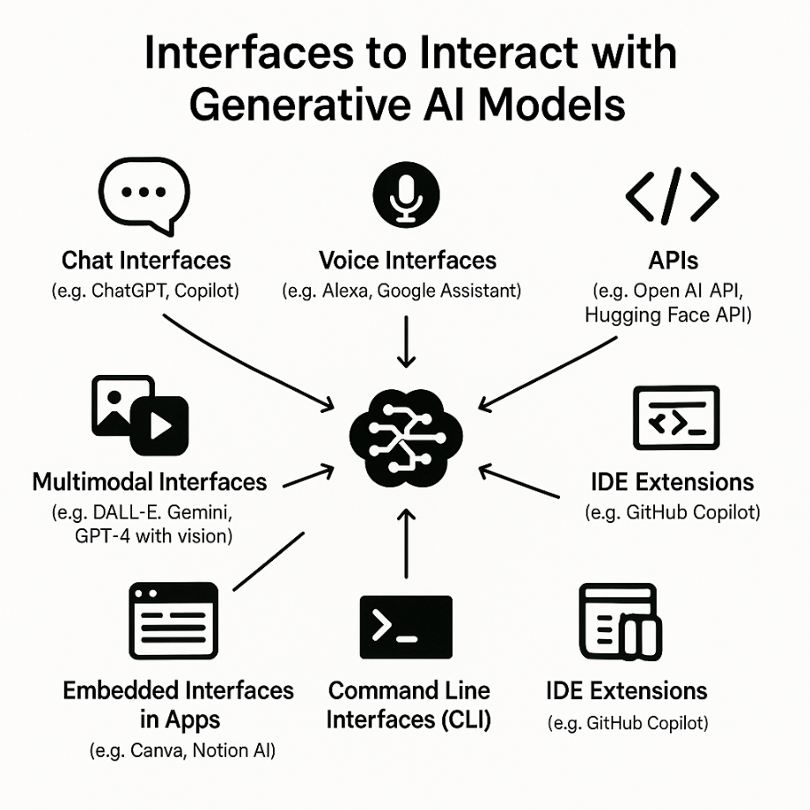
GenAI Prompts
1. Chat Interfaces
Examples: ChatGPT, Copilot, Claude, Bard
How it works: You type a question or request in a chat box.
Use case: General-purpose conversations, writing help, coding assistance.
2. Voice Interfaces
Examples: Alexa, Google Assistant, Siri (with GenAI integration)
How it works: You speak your prompt, and the system converts it to text.
Use case: Hands-free interaction, smart home control, voice-based search.
3. APIs (Application Programming Interfaces)
Examples: OpenAI API, Hugging Face API
How it works: Developers send prompts programmatically from apps or websites.
Use case: Embedding GenAI into custom software, chatbots, or automation tools.
4. IDE Extensions
Examples: GitHub Copilot in VS Code, Amazon CodeWhisperer
How it works: Prompts are given as code comments or instructions inside development environments.
Use case: Code generation, debugging, documentation.

Slide 12
GenAI Prompts
5. Embedded Interfaces in Apps
Examples: GenAI in Canva, Notion AI, Microsoft Word/Excel
How it works: You interact with GenAI through buttons, text boxes, or sidebars.
Use case: Content creation, summarization, design assistance.
6. Command Line Interfaces (CLI)
Examples: CLI tools using GenAI APIs
How it works: Prompts are typed directly into a terminal.
Use case: Developers and tech-savvy users automating tasks.
7. Multimodal Interfaces
Examples: DALL·E, Gemini, GPT-4 with vision
How it works: You give prompts using text, images, or even audio.
Use case: Image generation, visual Q&A, audio transcription,

Slide 13

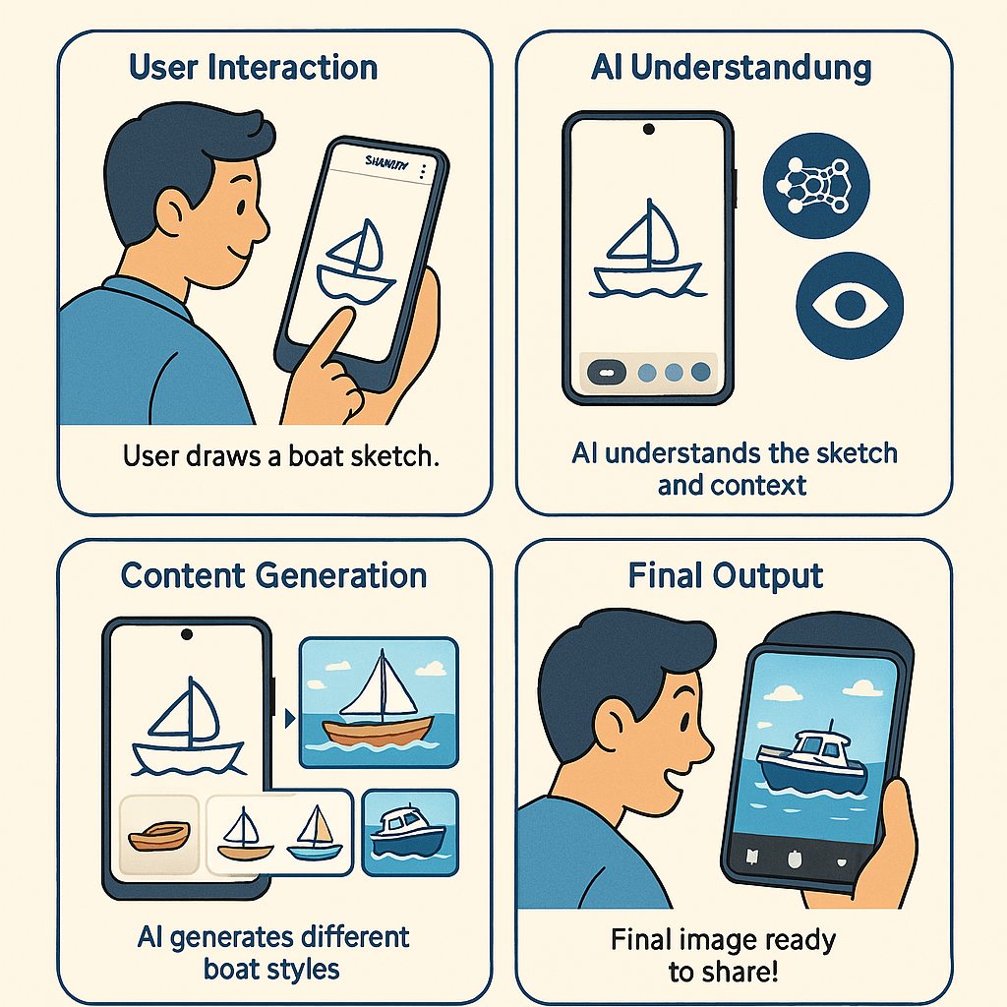
Fun Activity - Samsung Gallery: Draw a boat

Slide 14
AI Agents

Slide 15
AI Agents
Definition:
AI Agents are systems that perceive their environment, make decisions, and act autonomously to achieve specific goals.
AI Agents are a subset of AI, often combining ML, reasoning, and planning to operate independently in dynamic environments.
Key Characteristics:
Autonomy
Goal-oriented behavior
Interaction with environment
Examples:
Virtual customer service bots
Game-playing agents (e.g., AlphaGo)
Smart home assistants (e.g., Google Nest)

Slide 16

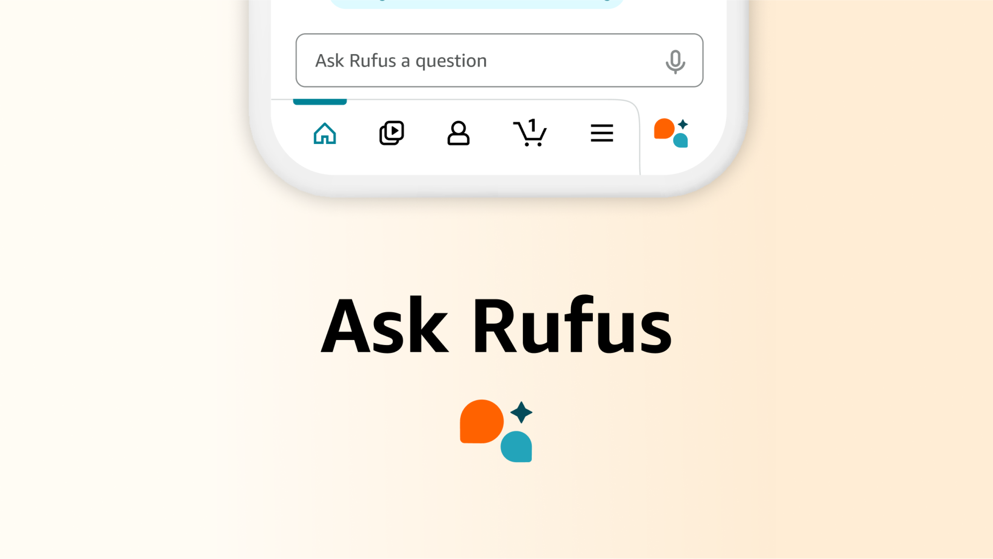
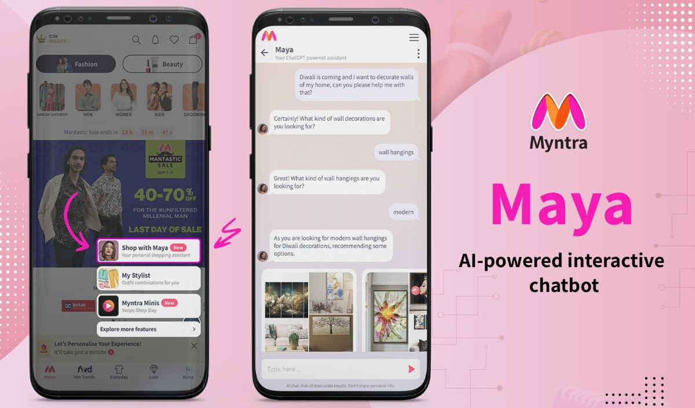
AI Agents in Action
Rufus is an AI-powered shopping assistant: it helps users find products, answers questions, offers comparisons, and gives personalized recommendations based on product details, customer reviews, and user preferences.
It uses large language models and generative AI designed to improve product search, decision-making, and shopping experience.
Rufus actively guides users but still operates within a defined scope—its actions and responses are limited to the Amazon product catalog and available user data.

Slide 17
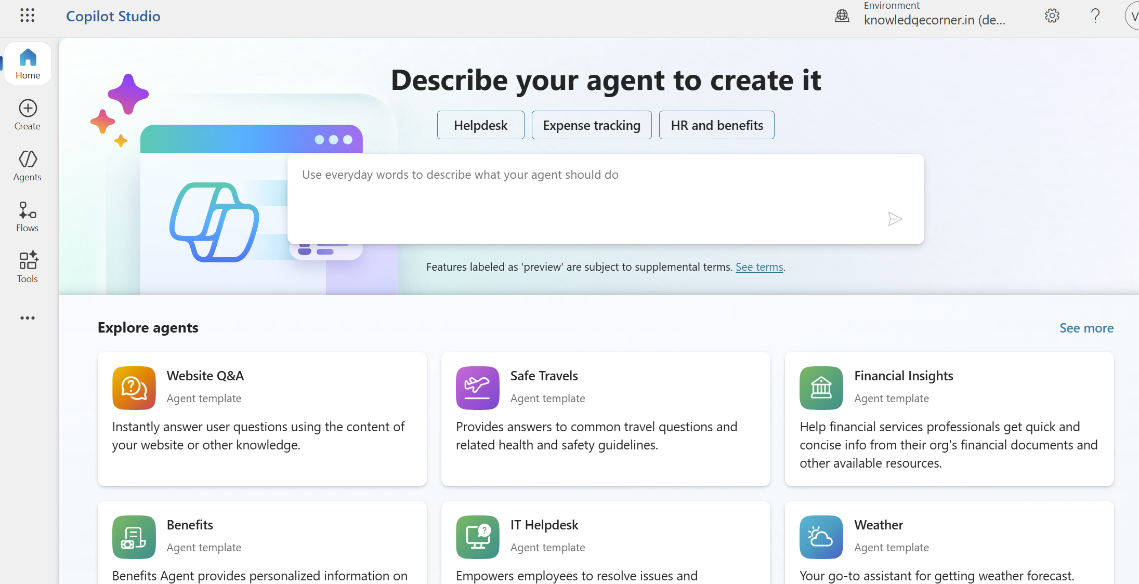
Custom AI agents
Using Microsoft Copilot Studio, you can design custom AI agents that:
Integrate with SharePoint, OneDrive, Teams, and other Microsoft 365 services
Search documents, folders, and project directories
Use plugins and connectors to access enterprise data
Respond with generative content using large language models (LLMs)
Automate workflows and trigger actions based on user input or system events

Slide 18
Feature | AI Agent | LLM | Chatbot
Core Functionality | Autonomously achieves goals, context-aware, executes tasks | Processes/generates language, no persistence or autonomy | Conversational interface, prompt-based responses
Memory | Maintains history, adapts to prior interactions | Stateless, no memory of past inputs | Sometimes session-limited memory; generally shallow
Decision-Making | Real-time, multi-step, autonomous | None; responds only to current input | Limited, rule- or script-driven with some context
Technology | Uses LLMs, API integrations, agentic logic | Advanced transformer or similar AI architectures | Driven by LLMs, NLP engines, or scripts
Scope | Performs actions beyond conversation (automation, integration) | Can be used for any text-driven tasks | Primarily used for communication or guided interactions

Slide 19
Agentic AI

Slide 20
Agentic AI
Definition:
Agentic AI refers to advanced AI systems that exhibit high degrees of autonomy, initiative, and long-term planning, often coordinating multiple tasks across tools and environments.
Agentic AI uses AI and builds upon AI Agents, but emphasizes autonomy, adaptability, and initiative. It’s not a strict subset but a conceptual evolution of agent-based AI.
Key Features:
Self-directed task execution
Tool usage and orchestration
Memory and context awareness
Multi-step reasoning
Examples:
AutoGPT and BabyAGI (autonomous task agents)
Personal AI assistants that plan, execute, and adapt
AI systems managing workflows across apps

Slide 21
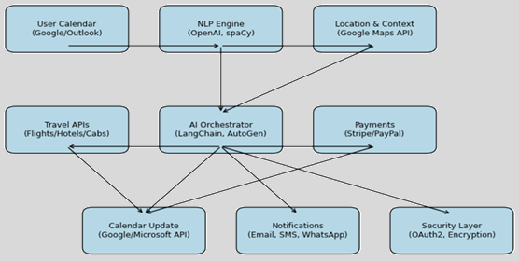
AI Agent vs Agentic AI system
AI Agent
Think of it like a smart assistant.
It waits for you to ask something, then gives a helpful answer or performs a task.
Example: You ask it to check your train ticket status, and it does that.
It reacts to your commands.
Agentic AI
Think of it like a smart teammate.
It can figure out what needs to be done, plan steps, and do things on its own.
It takes initiative and works independently.
Example: It notices you have a meeting in another city, books your travel, updates your calendar, and sends reminders—without you asking.

Slide 22
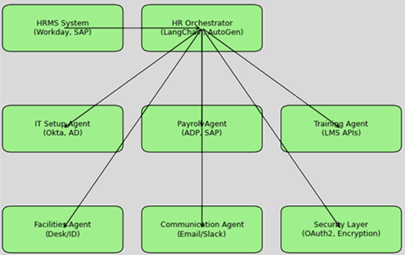
Example - Automated New Employee Onboarding
HR Orchestrator Agent (LangChain/AutoGen)
Reads new hire data from HRMS (Workday, SAP SuccessFactors).
Breaks down tasks → assigns to agents.
IT Setup Agent
Creates company email & Slack/MS Teams account.
Provisions laptop access & software licenses (Okta, Active Directory).
Payroll Agent
Adds bank details to payroll system (ADP, SAP).
Ensures tax forms are filed.
Training Agent
Enrolls employee in mandatory training (LMS).
Books orientation sessions.
Facilities Agent
Requests ID badge, desk allocation.
Communication Agent
Sends welcome emails, calendar invites, and reminders.

Slide 23
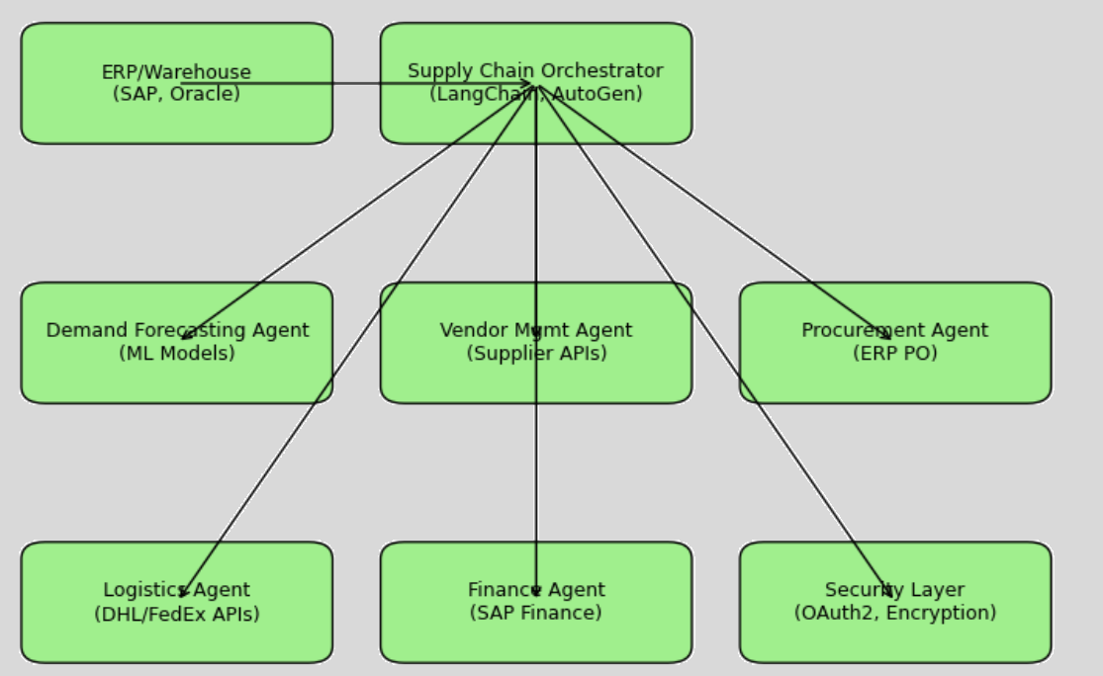
Example - Automated Inventory Replenishment
Supply Chain Orchestrator Agent
Continuously monitors inventory (ERP/warehouse API).
Detects low stock event.
Demand Forecasting Agent
Uses ML model (Prophet, XGBoost) to predict demand.
Adjusts required reorder quantity.
Vendor Management Agent
Checks supplier catalogs & lead times.
Selects best vendor (cost, speed, reliability).
Procurement Agent
Creates purchase order in ERP (SAP, Oracle).
Sends for approval (if required).
Logistics Agent
Books transport (FedEx API, DHL API, local fleet mgmt).
Tracks shipment in real-time.
Finance Agent
Updates accounts payable.
Schedules payment after delivery confirmation.

Slide 24
Types of Agentic systems
Single Agent Systems
One agent that takes input, reasons, and acts.
Reactive agents → respond directly to environment changes (e.g., chatbot that answers FAQs).
Deliberative agents → reason before acting (e.g., planner bot that decides steps for booking travel).
Learning agents → improve performance over time (e.g., customer support bot fine-tuned on past chats).
Example: A GitHub Copilot assistant helping with code completion.
Multi-Agent Systems
Multiple agents that collaborate or compete.
Cooperative agents → work together to achieve a goal (e.g., one agent fetches data, other analyses it, another generates report).
Competitive agents → negotiate or compete for resources (e.g., stock trading bots).
Example: In supply chain — one agent monitors inventory, other places orders, another optimizes logistics.
Orchestrated Agentic Systems
An orchestrator (or controller) coordinates specialized agents.
Central brain decides which agent to call and in what order.
Agents are usually task-specific (IT setup, payroll, training, etc.).
Example: HR onboarding orchestrator → coordinates IT, payroll, and training agents.

Slide 25
Types of Triggers in Multi-Agent Agentic Systems
External Triggers
User input (e.g., a prompt or command)
Sensor data (e.g., environmental changes)
System events (e.g., file updates, API calls)
Internal Triggers
Scheduled tasks (e.g., cron-like behavior)
Goal-based activation (e.g., an agent detects unmet goals)
Contextual awareness (e.g., memory or state changes)
Autonomous Triggers
In agentic systems, agents may self-initiate actions based on:
Long-term planning
Task decomposition
Environmental monitoring
Collaboration needs with other agents
Example: Agentic AI in Action
Imagine a personal AI assistant composed of multiple agents:
One agent monitors your calendar.
Another handles emails.
A third manages travel bookings.
If your calendar agent notices a meeting in another city, it can trigger the travel agent to book flights and the email agent to notify participants—without explicit user input.

Slide 26
LLM Comparison
rovider | Model Name | Context Window | Input Cost (per 1M tokens) | Output Cost (per 1M tokens) | Free Tier | Python Library | Message Format Example
OpenAI | GPT-4o | 128K | $1.25 | $5.00 | Yes (limited) | openai / litellm | {"role": "user", "content": "..."}
 | GPT-3.5 Turbo | 16K | $0.50 | $1.50 | Yes
Google | Gemini 1.5 Pro | 1M | $1.25 | $10.00 | Yes | google-generativeai / requests | {"contents": [{"parts": [{"text": "..."}]}]}
Anthropic | Claude 3 Sonnet | 200K | $3.00 | $15.00 | Yes (via Poe) | anthropic / litellm | {"role": "user", "content": "..."}
 | Claude 3 Opus | 200K | $15.00 | $75.00 | No
DeepSeek | DeepSeek-V2 | 128K | $0.55 | $2.19 | Yes (OSS) | transformers / requests | HuggingFace format
Groq | Mixtral / LLaMA | 32K–128K | Free (ultra-fast) | Free | Yes | litellm / requests | OpenAI-style
Ollama | LLaMA 3 / Mistral | 8K–32K | Free (local inference) | Free | Yes | ollama / litellm | OpenAI-style

Slide 27
Python Library Summary
Library | Install Command | Supports
openai | pip install openai | OpenAI models
anthropic | pip install anthropic | Claude models
google-generativeai | pip install google-generativeai | Gemini models
transformers | pip install transformers | DeepSeek, Ollama, OSS
litellm | pip install litellm | Unified access to all above
ollama | pip install ollama | Local models (LLaMA, Mistral)

Slide 28
Agentic Frameworks

Slide 29
Agentic Frameworks
Agentic frameworks are software architectures designed to build, manage, and orchestrate autonomous agents powered by AI.
Each agent typically has a goal, role, and capabilities (e.g., tools, memory, reasoning).
They enable multi-agent collaboration, allowing agents to communicate, delegate tasks, and solve complex problems together.
Often integrate with LLMs (Large Language Models) and external tools/APIs for reasoning, retrieval, and action.
Support various orchestration styles like sequential, graph-based, asynchronous, or protocol-driven workflows.
Useful in domains like automation, research, customer support, software development, and logistics.
Examples include LangChain, LangGraph, CrewAI, AutoGen, OpenAI SDK, and MCP.

Slide 30
Agentic Frameworks Comparison Table
Framework | Orchestration Style | Strengths | Limitations | Best Use Cases
LangChain | Chain-based (linear) | Rich ecosystem, modular, great for RAG and tool use | Complex for multi-agent setups | Chatbots, RAG apps, tool-augmented agents
LangGraph | Graph-based (DAG) | Precise control, stateful workflows, error handling | Steeper learning curve | Multi-agent orchestration, enterprise workflows
CrewAI | Role-based sequential | Easy setup, beginner-friendly, human-in-the-loop support | Limited dynamic control | Team-like agent setups, logistics, planning
AutoGen | Asynchronous messaging | Scalable, robust logging, cloud-ready, supports human-agent interaction | Setup complexity, limited persistent memory | IT automation, cloud workflows, research agents
OpenAI SDK | Function-calling agents | Direct integration with OpenAI tools, flexible, fast prototyping | Less orchestration control, minimal built-in memory | Prototyping, tool use, simple agent workflows

Slide 31
Common Components & Flow of Agentic Systems
1. Define Agents
Agents are autonomous units with a specific role, goal, and capabilities.
Each agent typically includes:
Name & Role: What the agent represents (e.g., "Research Analyst").
Goal: What the agent is trying to achieve.
Tools: APIs, functions, or external systems the agent can use.
LLM: The language model powering its reasoning.
Memory (optional): To retain context across tasks or sessions.
2. Define Tasks
Tasks are units of work assigned to agents.
Each task includes:
Description: What needs to be done.
Expected Output: Format or type of result (e.g., JSON, summary).
Assigned Agent: Which agent will perform it.
Context (optional): Input from previous tasks or external sources.
3. Define Process / Workflow
Specifies how tasks are executed:
Sequential: Tasks run one after another.
Parallel: Tasks run simultaneously.
Graph-based: Tasks follow a directed flow with dependencies.
Asynchronous / Messaging: Agents communicate and act independently.
4. Initialize System
Combine agents, tasks, and process into a crew, graph, or workflow object.
This object orchestrates the execution and manages data flow.
5. Run the System
Trigger the process with initial input (e.g., user query, email list).
Agents collaborate, pass outputs, and complete tasks.
Final output is returned or stored (e.g., file, API response).

Slide 32
Framework Documentation
Crew AI - https://docs.crewai.com/en/introduction
OpenAI SDK - https://openai.github.io/openai-agents-python/
LangChain - https://python.langchain.com/docs/introduction/

Slide 33
CrewAI vs LangChain
Feature | CrewAI | LangChain
Agents | Explicit Agent class | Implicit via tools and LLM
Task Dependencies | context=[...] | Handled manually or via chaining
Output Files | Built-in file handling | You handle file I/O manually
Process Flow | Process.sequential or Process.parallel | Manual control via function logic

